Slide 1
ASP.NET
Routing

Slide 2
Routing
1
Introduction

Slide 3
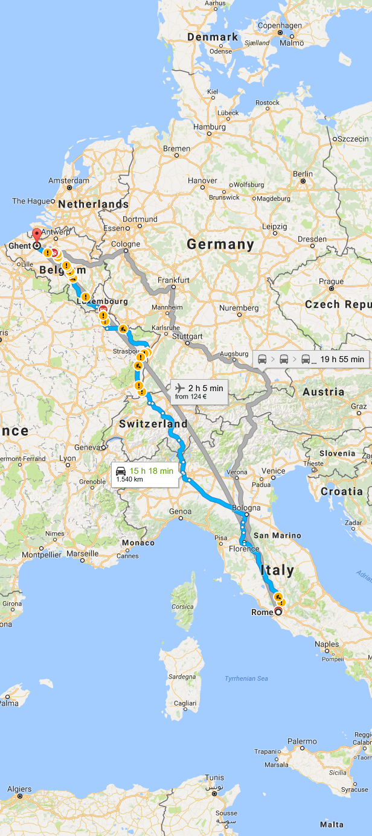
Basic Routing
The idea is that you specificy where you want to go to
Via the URL
ASP.NET uses URL matching to send you to
your endpoint

Slide 4
Basic Routing
URL Tips
As short as possible
Easy to remember
Don’t change the URL

Slide 5
Basic Routing
Before ASP.NET 5 your had 2 types of routing
Convention-based routing
Attribute-based routing
Convention-based
Define routes in RouteConfig.cs
Attribute-based routing
Introduced in ASP.NET MVC 5
No matter what you use, every route ends up in
RouteTable.Routes

Slide 6
Routing in ASP.NET Core
Rewritten from the ground up
For MVC as for Web API
No distinction for MVC and API controllers
Derive from the same controller class
Default routes are created automatically
No configuration
Rich set of inline constraints and parameters

Slide 7
URL Matching
Incoming request is sent to a specific handler with matches your request to a specific request handler
RouterMiddleware which calls the RouteAsync method
The IRouter.Route uses the template syntax that will look for patterns
A Route is created by using the MapRoute method

Slide 8
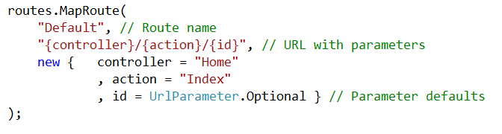
http://www.elmos.be/customers/list/register
controller: Customers
Action: list
Id: register

Slide 9
Routers.MapRoute
Default route
Add more routes to the RouteCollection
routes.MapRoute(
name: "default",
template: "{controller=Home}/{action=Index}/{id?}");
routes.MapRoute(
name: "blogRoute",
template: "blog/{action=Index}/{id?}",
defaults: new { controller = " BLog" }
);

Slide 10
Routing
2
Attribute Routing

Slide 11
Attribute Routing
Attaching a route, as an attribute, to a specific controller or action method
[Route("api/[controller]")]
[ApiController]
public class ValuesController : ControllerBase
{
Notes:
https://www.c-sharpcorner.com/article/routing-in-restful-apis-using-net-core/
https://blog.bitscry.com/2018/06/21/asp-net-core-api-routing/

Slide 12
// GET: api/Customer
[HttpGet]
public IActionResult Get()
{
return Ok(new string[] { "value1", "value2" });
}
// GET: api/Customer/5
[HttpGet("{id}", Name = "Get")]
public IActionResult Get(int id)
{
if (id > 0) return Ok("value");
return NotFound();
}
// GET api/Customer/top
[HttpGet("top/{n}")]
public IActionResult GetTopN(int n) {
}

